Slide 1
Cisco Ask Product Teams
Q&A Partner Summit 2023
April 2023

Slide 2
FY22 Recap and Outcomes
Feedback | Outcomes
Partners have no visibility into roadmap | Quarterly roadmap updates, Webex coming soon updates
No proper communication on new features | EA announcements, Webex what’s new updates
Platform stability concerns | Reliability our platform strength
Roadmap Input | Features released

Slide 3

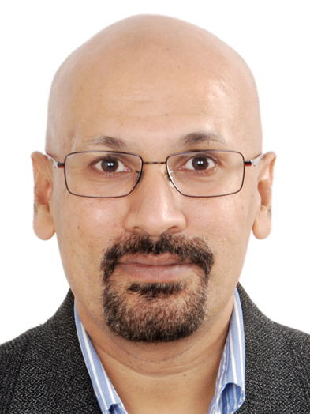




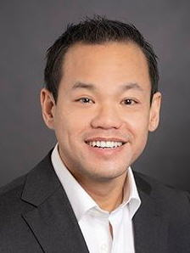


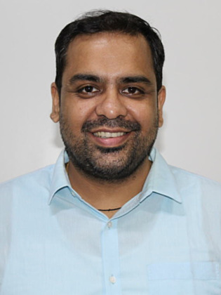




Contact Center PM|GTM Leadership
Rui
Brettes
Rajen
Goel
Arvi Krishnaswamy
Daniel Jonathan Valik
Emerik Giorgetti
Girish
Variyath
Jono Luk
Product | GTM
Reduce Customer
Time-to-Value
Drive efficiency with Orchestration & Automation
Empower key customer-facing employees
Enable best action with data & insights
Make Contact Center truly
omni-channel
Webex CCE and CC
Willem Evert Nijenhuis
Contact Center Product
Connie Tang
Developer Platform
Leadership Teams focused on delivering specific customer outcomes by building innovative solutions
Sandeep
Bajaj
Raj
Kumar
Rahul
Dubey
Zack Taylor
Strategic Communication
Kevin McPartlan
Offer Management
Outbound/
Routing & Queuing
Security & Compliance
Market Access

Slide 4
How to reach out
For questions on released features
Reach out to your respective Customer Success Manager
Or
Submit a request through the Webex Calling Help Desk (now also supports WebexCC)
For product roadmap questions
Refer to the Quarterly Cisco Collaboration Roadmap (Next publish April 27)
Or
Reach out to Product management team at the below mailer: pmfeedback_cc@cisco.com​

Slide 5


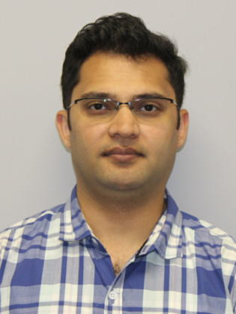

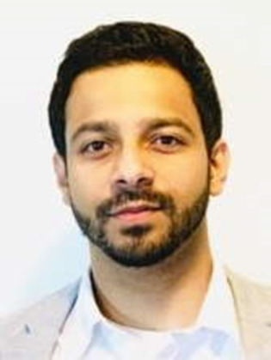

Enable best action with data & insights
Our Product Team
Daniel Valik (Lead)
Christian Braun
JDS, WXM
Scott Stone
Billing/Reporting
Hardik Modi
CC Analytics
Aaron Buda
WXM
Varun Kulkarni
Analyzer
Zubin Dang
JDS
Providing a data platform, analytics, and reporting to enable all customers and partners for our services to understand what is going on across their contact center in the format and location that works best for them.
Our Mission
Customer Journey Data Service
Experience Management
Analyzer
Usage Based Reporting and Billing
Data Platform Services
Services/
Products
we drive
Unified Reporting and Analytics for Contact Center (Cloud and On-Premise)
Analyzer for Contact Center
Journey Data Service
Experience Management (WXM)
Usage Based Billing and Reporting
Roadmap
Highlights
(6 months)
Journey Data Service Early Access and Launch
Experience Management V2 Early Access
Usage Based Billing and Reporting Pilot
Unified Reporting Early Prototype
Analyzer UX Refresh
Analyzer V2 Prototype

Slide 6


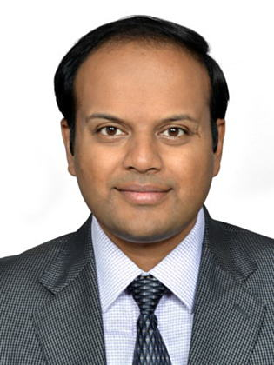
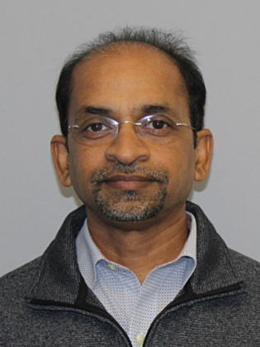

Make CC truly omnichannel
Our Product Team
Emerik Giorgetti
Team Lead
Shantanu Nandi Digital Channels
Bryan Morris
Real-time media
Dennis Marshall
WebRTC
Sandeep Bajaj
Outbound
Vikram Gururaj
Routing & Queuing
SK Kolavennu
Recording
Enable companies to have rich, intelligent, personalized interactions with their customers across any channel
Our Mission
Services/
Products
we drive
Global real-time media services (RTMS) with local / regional points-of-presence
WebRTC and SDK for app development / integration
Digital channels (powered by Webex Connect)
Routing and queuing
Outbound
Recording and transcription
Roadmap
Highlights
(6 months)
Simplification of digital channel flows (Webex CC)
Transcription APIs
New digital channels: Apple Business Chat
Enterprise CC: WhatsApp, FB Messenger, ABC
Webex CC: Progressive dialing
WebRTC (Agent and Supervisor Desktop)
RTMS GA in new geos (UK, GER, AUS, IND, SGP, etc)

Slide 7
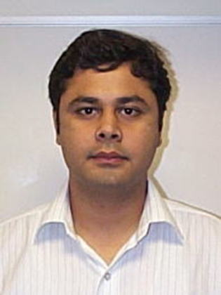

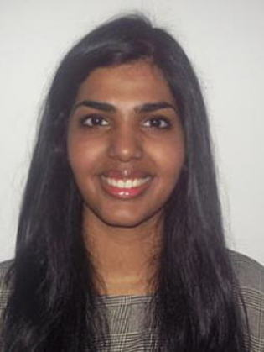
Drive Efficiency with Orchestration and Automation
Our Product Team
Rajen Goel
Lead +
Flow Designer
Ankush Jaggi
Webex CC IVR, CVP / VVB
Puneet Shrivastava
Virtual agent
Soundarya Muthuvel
Dev. eco-system
Enable continually improving omni-channel self-service experience which customers prefer, to optimize need for human agent interaction.
Enable non-developers to create & manage self-service automation workflows using easy to use low-no code tools.​
Enable partners to create and monetize integrations using APIs by providing a rich developer eco-system.​
Our Mission
Services/
Products
we drive
Webex CC IVR
Webex CCE IVR (CVP/VVB)
Virtual agents
Flow Designer
Developer eco-system (Portal, APIs, AppHub)
Analytics for self-service automation
Roadmap
Highlights
(6 months)
Flow Designer enhancements
New capabilities: Flow environments, Sub-flows, Graphical Flow analytics, Percentage-based forking
Improved usability - curved lines, flows organization, search, VIEW only access
Webex Contact Center IVR - Native speech IVR (TTS, Directed dialog), Record utterance
Virtual agent: Dialogflow CX/ES, Webex Connect Bot builder (voice), Nuance Mix, Analytics for automation (topic modeling)
Developer - Search capability, Developer Sandbox, New User Sign up, 3rd Party virtual agents

Slide 8
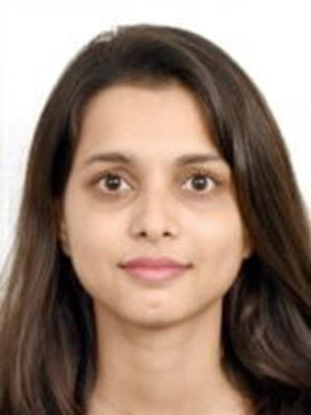
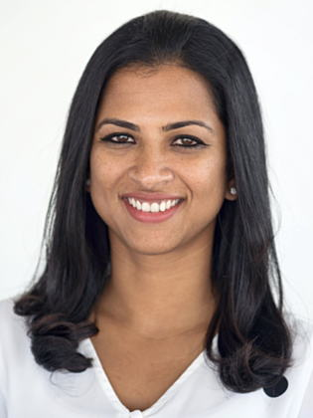
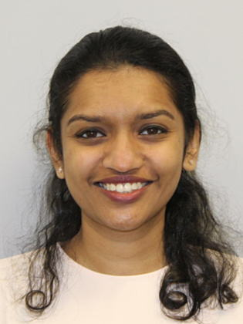

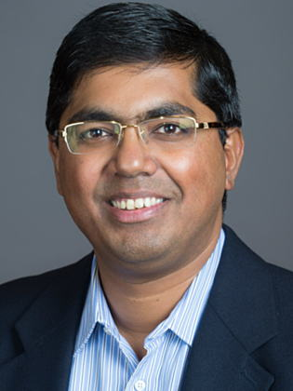

Empower customer facing employees
Our Product Team
Arvi Krishnaswamy
Karishma Manshani
Padmini Krishnan
Janani
Ramakrishnan
Ramya Tummala
Rajiv
Krishnan
Adikeshav C
Empower customer-facing employees to intelligently offer a personalized experience to end customers who connect with their business.
Efficient Turnarounds ⬩ Deeper Relationships ⬩ Agent Wellness ⬩ Real-time Supervision
Deliver the experiences and capabilities needed for human agents, and their supervisors (scope: from the point of human contact through the end of the interaction)
Our Mission
Services/
Products
we drive
Desktop & UUIP (Adikeshav), Finesse (Rajiv)
Efficient Turnarounds (Rajiv)
Real-time Supervision (Padmini)
CRM & MS Teams Integration (Adikeshav)
Customer Journey (Rajiv)
Agent Answers and Auto Responses (Ramya)
Quality Management (Padmini)
Roadmap
Highlights
(6 months)
Supervisor Core (Janani)
MS Teams & Dynamics Interop (Adikeshav)
Omni-channel Customer Journey (Rajiv)
Agent Answers (digital) (Ramya)
Auto Responses via ChatGPT3 (EA)

Slide 9



Reduce Customer Time-to-Value
Our Product Team
Rui Brettes
Priyobrato Chatterjee
Jonathan
Cook
Zach
Tajerstein
Our team is focused on reducing customer Time to Value (TTV), it refers to how much time it takes a
customer to realize and extract value from our products or services.
Our Mission
Services/
Products
we drive
Hybrid Platforms, Migrations (Priyo)
Admin & Partner Experiences (Zach)
Provisioning, Onboarding & Activation (Jonathan)
Tenant Core automation (Priyo)
Roadmap
Highlights
(6 months)
Control Hub WxCC Administration
Partner trials, demos
Smart default templates
Hybrid Connector improvements

Slide 10
Ask Product Teams
Q&A Partner Summit 2023

Slide 11
Summary Q&A
Question | Answer
A single desktop for agents "Webex Client", that is the Phone / Contact Center all in client. This should have full line state awareness within Webex calling. | As part of our roadmap, we have a feature that will allow agents to synchronize presence from the Webex app to the Webex contact center. In the long term, we are also exploring options to embed the Agent Desktop within the Webex app to achieve greater interoperability.
A single pane of glass for administration (reporting,desktop,voice/digital flows). Multiple admin portals / logins is not acceptable anymore | We are working to consolidate all admin portals into Webex Control Hub. You can expect to see some updates being released in the upcoming months.
Are there any battle cards / documentation comparing WxCC features against lead cloud contact center solution providers i.e inContact, Genesys etc. | We are working on several pieces of documentation to address general competitive differentiation between cloud contact center market participants.
Can we copy visualization formulas between reports? Some formulas use nested fields and would be nice not to have rebuild in another report. | Hi Roxie - currently this is limited. But this is being considered as an enhancement as part of the later UX Refresh phases.
Can we copy visualization formulas between reports? Some formulas use nested fields and would be nice not to have rebuild in another report. | Thank you for your question, Roxie! Currently we are looking into options to copy visualization formulas but it's indeed on our backlog for future versions. Please let me check on current status and get back to you asap. Let me also share my email: djonatha@cisco.com and happy to engage directly. Please let me follow up.
Can we copy visualization formulas between reports? Some formulas use nested fields and would be nice not to have rebuild in another report. | however, if the formula is created as a global formula, it can be copied over across reports otherwise it cannot at this very moment.
Can we get the ability to view & enable/disable available features in CC Management Portal? | Not in immediate plans, but could you share which specific features need a enable/disable option and the value this helps provide?
Can we have in the Gold Tenant the possibility of making demos with WhatsApp without having to pay the connection? It is a high cost for South America. | There is no "connection" cost for WhatsApp. The WhatsApp billing model is based on conversations and messages, and the rates are pretty low even for South America. Unless you have thousands of conversation and messages in your demos each month, your cost won't exceed maybe a couple hundred dollars / month, and very likely will be less than $100/month. Please feel free to reach out directly egiorget@cisco.com if you want to explore this in more detail, would be glad to assist
Cisco's strategy is to offer Webex Contact Center along with Webex Calling (this is ideal); for this we require RTMS. When will we have RTMS in Brazil? | Currently we provide a VPOP integration into Brazil, we do plan to review our offering in Brazil but we don't have a committed timeline at this moment. If you have specific businness cases please reach out to me directly.

Slide 12
Summary Q&A
Question | Answer
For those all in on Microsoft Teams, any plans to enhance the interoperability beyond direct routing of phone calls? Such as embedding the agent as an app? | We have a long list of roadmap items to improve interoperability with Microsoft Teams, including: 1) Agent ability to view MS Teams users' presence and metadata during consult or transfer 2) Synchronization of MS Teams and Webex Contact Center status to avoid RONA scenarios 3) SIP URI support for consult/transfer calls to MS Teams users 4) Embedded agent desktop experience in MS Teams. Check our partner roadmap deck for the latest updates.
Google CCAI Licensing Questions: What is the difference between ML- Premium and ML-Standard SKUs? | Premium is better in experience than Standard, for example for Text to Speech Premium voices are more human like as compared to the Standard voices, similarly for Speech to Text Premium offers a telphony adaptive model with lesser transcription errors as compared to the Standard Speech to Text.
I see progressive dialing on the 6 month roadmap. Will that be dependent on RTMS and if so, what is the timeline to migrate WxC integrated tenants to RTMS? | Progressive dialing will require RTMS. RTMS is available today for customers using VPOP integration. Today migration to RTMS is on request via the Solutions Assurance team, we are currently working through a program to migrate all customers to RTMS which will rollout over the coming months and will see all customers moved. Customers using Webex calling with CTI stack will be able to migrate as the WxC/RTMS integration becomes available in specific regions. WxC integration will be available in Japan shortly followed by Australia and US in the summer.
If a CSM is not assigned, how do we get feature flags enabled for a customer? | Please raise a support request at the following helpdesk link which now also supports Webex contact centre: https://callinghelp.webex.com/phd/
In WxC we can initiate the porting of the numbers directly from the portal. Can we have a similar porting process in WxCC portal as well? | Hi Rohit -- let me follow up with my PM. We will get back to you directly.
Is Epic on the CRM connector roadmap for the healthcare industry? | I can confirm that Epic is not currently on the CRM connector roadmap. Our team has thoroughly evaluated various options and prioritized based on market demand, technical feasibility, and other factors. However, we will monitor demand for Epic Connector before considering for roadmap inclusion.

Slide 13
Summary Q&A
Question | Answer
Is personalized training available? | Can you clarify what kind of personalized training are you looking for?
Is there a feature map from UCCX/UCCE to WxCC or can one be created? | Roxie, we are in the process of updating the document and will post it on the partner community.
Is there a feature map from UCCX/UCCE to WxCC or can one be created? | In addition to what Girish mentioned, I wanted to check with you - Would it make sense to support UCCX Skill based routing techniques like route to Most Skilled, route to Skill by weight, route to Skill by order, route based on Shortest Average Handle time etc. Please respond back to me 1x1 (vigurura@cisco.com)
Is there any roadmap that customer can limit the number of Overages seats allowed on the tenant? | Thank you for the question. Please let me check on some details and get back to you asap today.
It would also be good to get a comparison between WebexCC vs. competitors like Genesys for instance as far as feature comparison. | Due to the number of CCaaS competitors and the continuous delivery nature of the market we do not do feature by feature comparisons.
One of the challenges we are facing is WxCC trials, any options with partners lead trials via the control hub, similar to Webex Calling? | We are working on defining a scalable and simplified Trial experience. The PM Team will reach out to all partner community once we're ready to disclose the plan.
Passing skill & value to queue node as variable (like QueueID). | Hi Roxie, can you please explain the usecase here
Please provide a detailed list of what's on the roadmap in coming months. We have to get this information from a variety of sources & they sometimes contradict. | Please use the "coming soon" section at the following link to see the month wise list of features planned to be rolled out. https://help.webex.com/en-us/article/a1gx3h/What's-New-in-Webex-Contact-Center#Cisco_Reference.dita_ac59c83e-b1ab-4c83-9895-1217740dcfe4
Please provide a detailed product comparison/roadmap of WebexCC vs. WebexCCE vs. CCE and what Cisco is now recommending for which type. | Bill, we are in the process of updating the document and will post it on the partner community when completed.
Possible solution to receive both voice and sms sent to the same phone number | Can you please clarify the use case? Do you mean ability to send sms to the caller mobile phone while caller is on a voice call with the agent?
Possible solution to receive both voice and sms sent to the same phone number | Hi Kristen - if you are referring to using the same contact center number for voice and SMS... it's possible but it's a bit complicated as it depends on the Service Provider capabilities. Would be glad to discuss in more detail if you want - pls reach out egiorget@cisco.com

Slide 14
Summary Q&A
Question | Answer
Regarding Wrap-Up. We do have AHA for it. Use case is no wrap state at all. CCE and CCX do not force Wrap state. We need that feature. | Noted, thanks for the feedback. We shall keep this feedback in mind for future consideration.
The provisioning process is a mess. We always have issues that delay the project. Are there any plans to streamline the process from a2q to tenant provisioning? | We are working on optimising the provisioning flow. stay tuned for the provisioning session that will cover some of those initiatives.
Variable playback (ANI, DNIS, etc) without TTS - currently using splice to parse variable and match each digit to wave file (ie 1.wav, 2.wav...). | If we offer support for TTS as part of the IVR, would you still need this functionality?
We appreciate the roadmap transparency, but need to do a better job of hitting ETAs. i.e. I believe Supervisor desktop was originally planned for last November. | Appreciate the feedback Don. The Supervisor desktop was a major release and we did hit some roadblocks that delayed the launch. We have made a lot of changes in how we are organized, how we plan and scope roadmap and expect these changes to provide better guidance and transparency you have mentioned to our partners and customers.
We need the ability to transfer a call back to a queue where the only logged in agent previously handled the call. | Thanks Don. What is the exact usecase here? Who is the customer asking for this and how many customers are requesting this feature. Please let me know
We need to be able to disable "WrapUp" for certain customers, We want to turn Wrap OFF completely | We have not heard this ask from customers. Please raise an Aha for it, so that it can be tracked for future consideration. However, I would like to understand the use case better. Is this about disabling wrap up state or is this about not allow the agent to submit a wrap up reason ? Also, please elaborate on the use case in play here.
We need to be able to disable "WrapUp" for certain customers, We want to turn Wrap OFF completely | Customers are looking for an option to turn off wrap up step completely as not all contract centers have a need for it. (Feedback from CDW)
We need to be able to disable "WrapUp" for certain customers, We want to turn Wrap OFF completely | Noted, please raise an Aha, so that the feature can be tracked for future consideration.
We need to be able to disable "WrapUp" for certain customers, We want to turn Wrap OFF completely | We shall consider https://ciscocollaboration.ideas.aha.io/ideas/COLLAB-I-13565 as part of roadmap consideration if we hear further customer feedback on this topic.
We need to be able to disable "WrapUp" for certain customers, We want to turn Wrap OFF completely | Wrap enhancement is currently part of the roadmap (No tentative dates for now) which will include creation of wrap up activity in the flow so that flow developers have the access to wrap up function and will not require agent intervention.

Slide 15
Summary Q&A
Question | Answer
What is being done to improve QA? A recent project had 9 BEMS tickets opened by the CSM for product defects. This erodes customer confidence from day 1. | We are sorry to hear that you're having those issues. The engineering team is fully committed to improve our quality and availability.
When will the ability, if at all, be there for a single customer to have multiple WxCC tenants in the same Org? IE: A county that supports multiple departments. | Hi Morgan we are approaching multi tenancy in stages. First we want to allow customers within a single tenant to fence configs that are dedicated to a single department through fine grained access control. Post that we will approach the physical multi tenancy.
When will the Control Hub Subscription licenses be able to accurately reflect concurrent license usage? | Thanks for the question - this is considered for future roadmap and will be addressed by our teams. We will provide an update asap.
When will the webrtc agent be available? | We plan to start making webrtc available starting in July, We will do a regional rollout with Europe being first but with US shortly after.
When will they add an equivalent to the CCX Doc Repository? A lot of call flows need some sort of persistent config state using more complex XML/JSON structure. | Its on our backlog to support persistent store natively in flow designer. We don't have a timeline to share at this point.
When will WxCC get reporting for Skills-Based Routing? | Skill based routing reports are available today. Please let me know if you are looking for anything specific
Which is the roadmap for enable our own Cisco AI solution be able to work with non-English language? Spanish, Portuguese | Non-English Language support is on our roadmap for all our native AI features, we would be releasing English first and get customer and partner feedback and then extend the solution to other popular languages used by our contact center customers.
Why moving to RTMS we do not support Dialogflow ES anymore but only CX? That will bring customer to extra development time and costs? Why cannot support both? | We understand the concern and we already have DF ES with RTMS as one of the immediate roadmap items.
Will calabrio be available for us to demo in our gold tenant? | We are working with the Webex WFO team to evaluate that possibility, no time frame for this yet.
Will or can partner admins have access to customer’s analyzer to assist in reporting? Today I’m utilizing a premium seat to have access. | External admins today should have access to Analyzer. Please raise a defect with the use case that does not work.
Will we have the ability soon to save desktop/portal layouts? Example: Supervisor applies filters to their portal dashboard, when they log out it doesn't save. | Layouts can be created, saved and applied to team(s), it is detailed here : https://www.cisco.com/c/en/us/td/docs/voice_ip_comm/cust_contact/contact_center/webexcc/SetupandAdministrationGuide_2/b_mp-release-2/b_cc-release-2_chapter_011.html?bookSearch=true#topic_BF0EBDF65DCB0A552164D6306657C892

Slide 16
Summary Q&A
Question | Answer
Will we have the ability soon to save Supervisor portal layouts? Example: Supervisor applies filter to their portal dashboard, when they log out it isn't saved. | Layouts can be created, saved and applied to team(s), it is detailed here : https://www.cisco.com/c/en/us/td/docs/voice_ip_comm/cust_contact/contact_center/webexcc/SetupandAdministrationGuide_2/b_mp-release-2/b_cc-release-2_chapter_011.html?bookSearch=true#topic_BF0EBDF65DCB0A552164D6306657C892
Will we have the ability soon to test Agent/Supervisor functionality & configure digital channels as External Admin (no account required in customer domain)? | Please elaborate on the use case here.
Will we have the ability soon to test Agent/Supervisor functionality & configure digital channels as External Admin (no account required in customer domain)? | The ask here is to have an ability to login to agent desktop as an external admin and receive voice or digital channel contacts- Ans. We have challenges today in allowing an external admin to access to features controlled through licenses such as access to voice and digital. That said we have this feature on our roadmap and working to solve the problem described.
Would like the option to group objects in flow designer (like Visio). | Noted. Will consider adding to the roadmap.

